Slide 1

Crypto Price Prediction Group D

Slide 2
Team members
Name | Role/ Expertice
Rodrigo Velazquez | Project Manager/Data Scientist
Bibek | Software Engineer
Mayisha | Machine Learning Engineer
Venkat | Software Engineer
Janani | Quantitative Analyst
Urjeet | Quality Assurance Engineer
Isha | Data Scientist
Tina | Quantitative Analyst

Slide 3
Why this topic?
We choose this topic for some reasons:
1-Our main topic included image processing which supposed a more advance project with topics that we still haven’t seen on college, so we decided to choose a project that let us put in practice some of the concepts we’ve seen so far.
2-Considering that the majority of projects in school tend to be about house pricing or health, we wanted to avoid the common projects.
3-It could be very interesting to create our own model and use it to predict the prices trends for cryptos with an up to date dataset.

Slide 4
Scope and goals
In simple terms based on the historical data of the crypto currency prices we want to predict the trend of prices for the future values of the price.
In order to do this we need a model to train and a dataset to train that model.

Slide 5
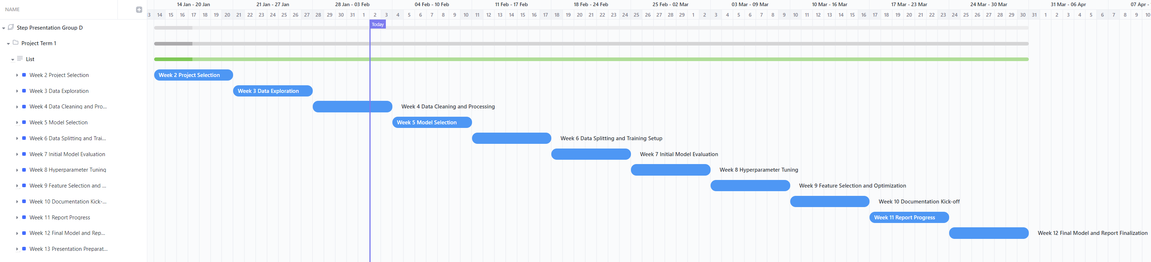
Gant Diagram
For the PM of this project we are using ClikUp to assign roles, workload, see the deliverables for each week, develop a timeline and gant charts.
https://app.clickup.com/9017184916/v/g/8cqemmm-417

Slide 6
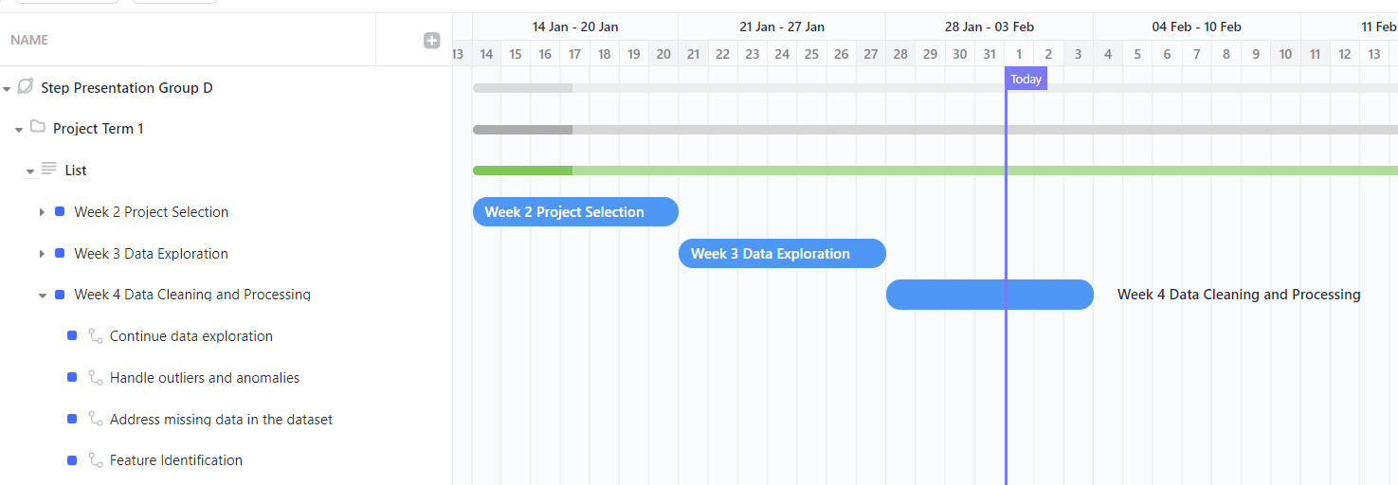
Where we are today
As seen from our gant diagram, on week 4 we continue with the data explration, we searched for outliers and anomalies as well, we identified missing data.

Slide 7
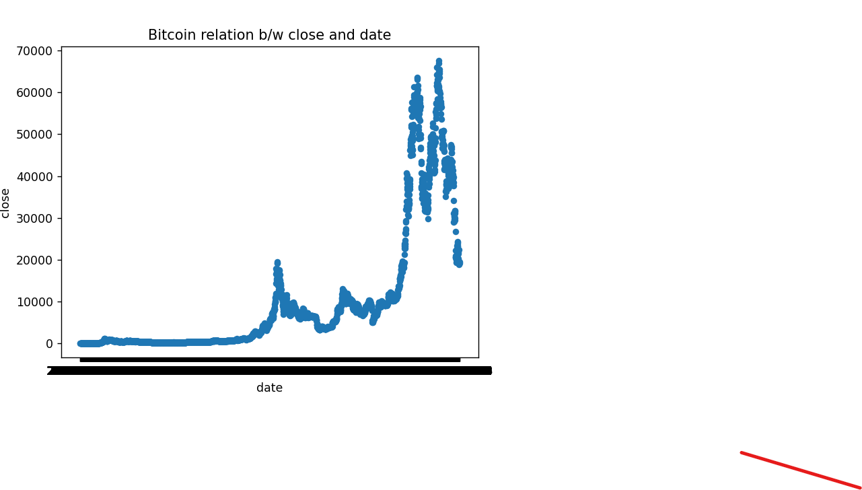
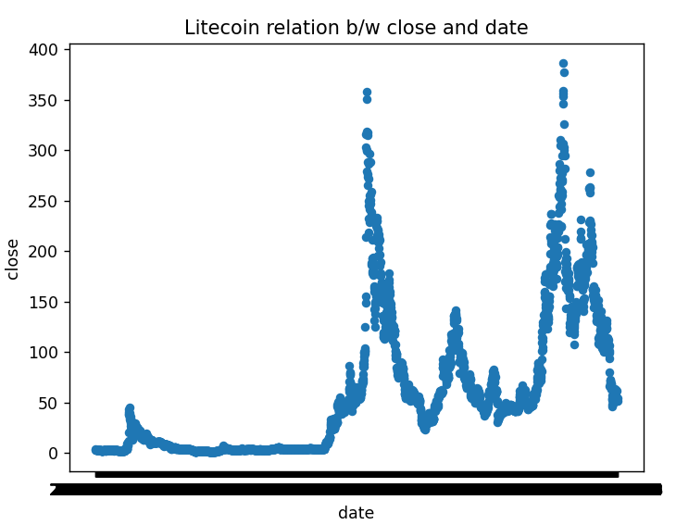
Findings
Scattere plot b/w colse value and date for BitCoin
Scattere plot b/w colse value and date for BitCoin
No Null (or) Empty values, Missing data in any of the column in the dataset.

Slide 8
What is training in ML
First of all lets explain what is ML and what does it mean to train a model.
In Machine Learning(ML) the machines learn a relationship between input data and the desired output for input data based on an algorithm.
Machine learning uses supervised, unsupervised and reinforcement learning techniques.
Supervised learning trains a model based on an algorithm using existing data and corresponding output labels or values and then the trained model is used to make predictions on new data samples.
In our particular case given that the data that we are using is a continuous set of numbers, we need to use supervised training to accomplish a regression.

Slide 9
What is a regression
A statistical method known as regression establishes a relationship between a dependent variable and one or more independent (explanatory) variables.
A regression model can show whether changes observed in the dependent variable are associated with changes in one or more of the explanatory variables.
In essence, it fits a best-fit line and observes how the data is distributed around it to do this.
It helps the analyst to help to make asset valuations and making prediction.
There are two basic regression types Linear and Multiple linear regression.

Slide 10
The data itself
We retrieved our data from Kaggle, which is a subsidiary from Google, and it’s an online community for engineers of all fields, that allows the users to find and access datasets used to build AI models.
This is the link for our dataset: https://www.kaggle.com/datasets/maharshipandya/-cryptocurrency-historical-prices-dataset
Now lets see the data itself!

Slide 11
The Dataset
It contains 9 columns
It contains 72946 registers or rows
It contains info for 56 different cryptos
The start and end date for our data is 2013-05-05 / 2022-10-23
Some potential challenges we saw during the exploration were: Value of crypto totally depends upon the investor and market demands. So, market value can highly be affected by external factor as well.
The columns that we would be using to train our model probably are: open, low, high, close, volume, crypto name, date

Slide 12
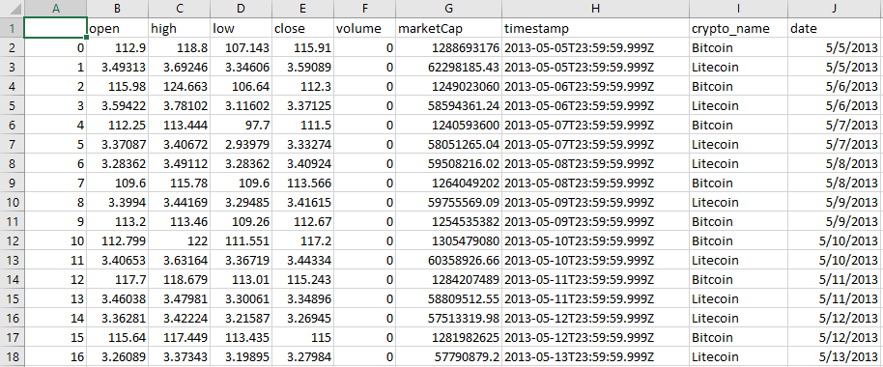
The Dataset
Insert Image of the excel dataset

Slide 13
Exploring the data
In order to start the data exploration, we mixed our group with Leandro’s group during the weekend to deliver 2 hour training on: Jupyter notebook, pandas and python.
By doing so we give each member of both teams the basic tools they need to access and start manipulating the data.
Link to the training recording:

Slide 14
Data accessing and exploration code
Insert the code we are currently developing:

Slide 15
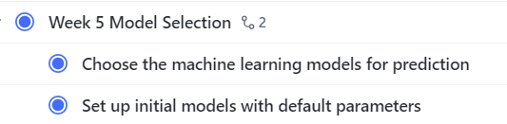
Next Steps
So for week 5 our next milestone is to start with the model selection

Slide 16
Thanks
Questions?

